Slide 1

The Lucky Golden Tree
Public Roadmap V1
No: 2022/Roadmap/V1-pub
Release : 05/02/2022

Slide 2
The Lucky Golden Tree
Public Roadmap V1
This public roadmap contains basic information regarding The Lucky Golden Tree Project.
The time periods mentioned here are representative and can be pre/postponed depending upon completion of sales of that particular stage.
Stage 1.3 and Stage 1.4 public roadmaps will be released accordingly.
Profits for buyers will start at S-1.2, whereas higher returns at S-1.3 and 1.4 respectively.
Detailed roadmap is one of the unlockable content for a TLGT NFT holder.

Slide 3
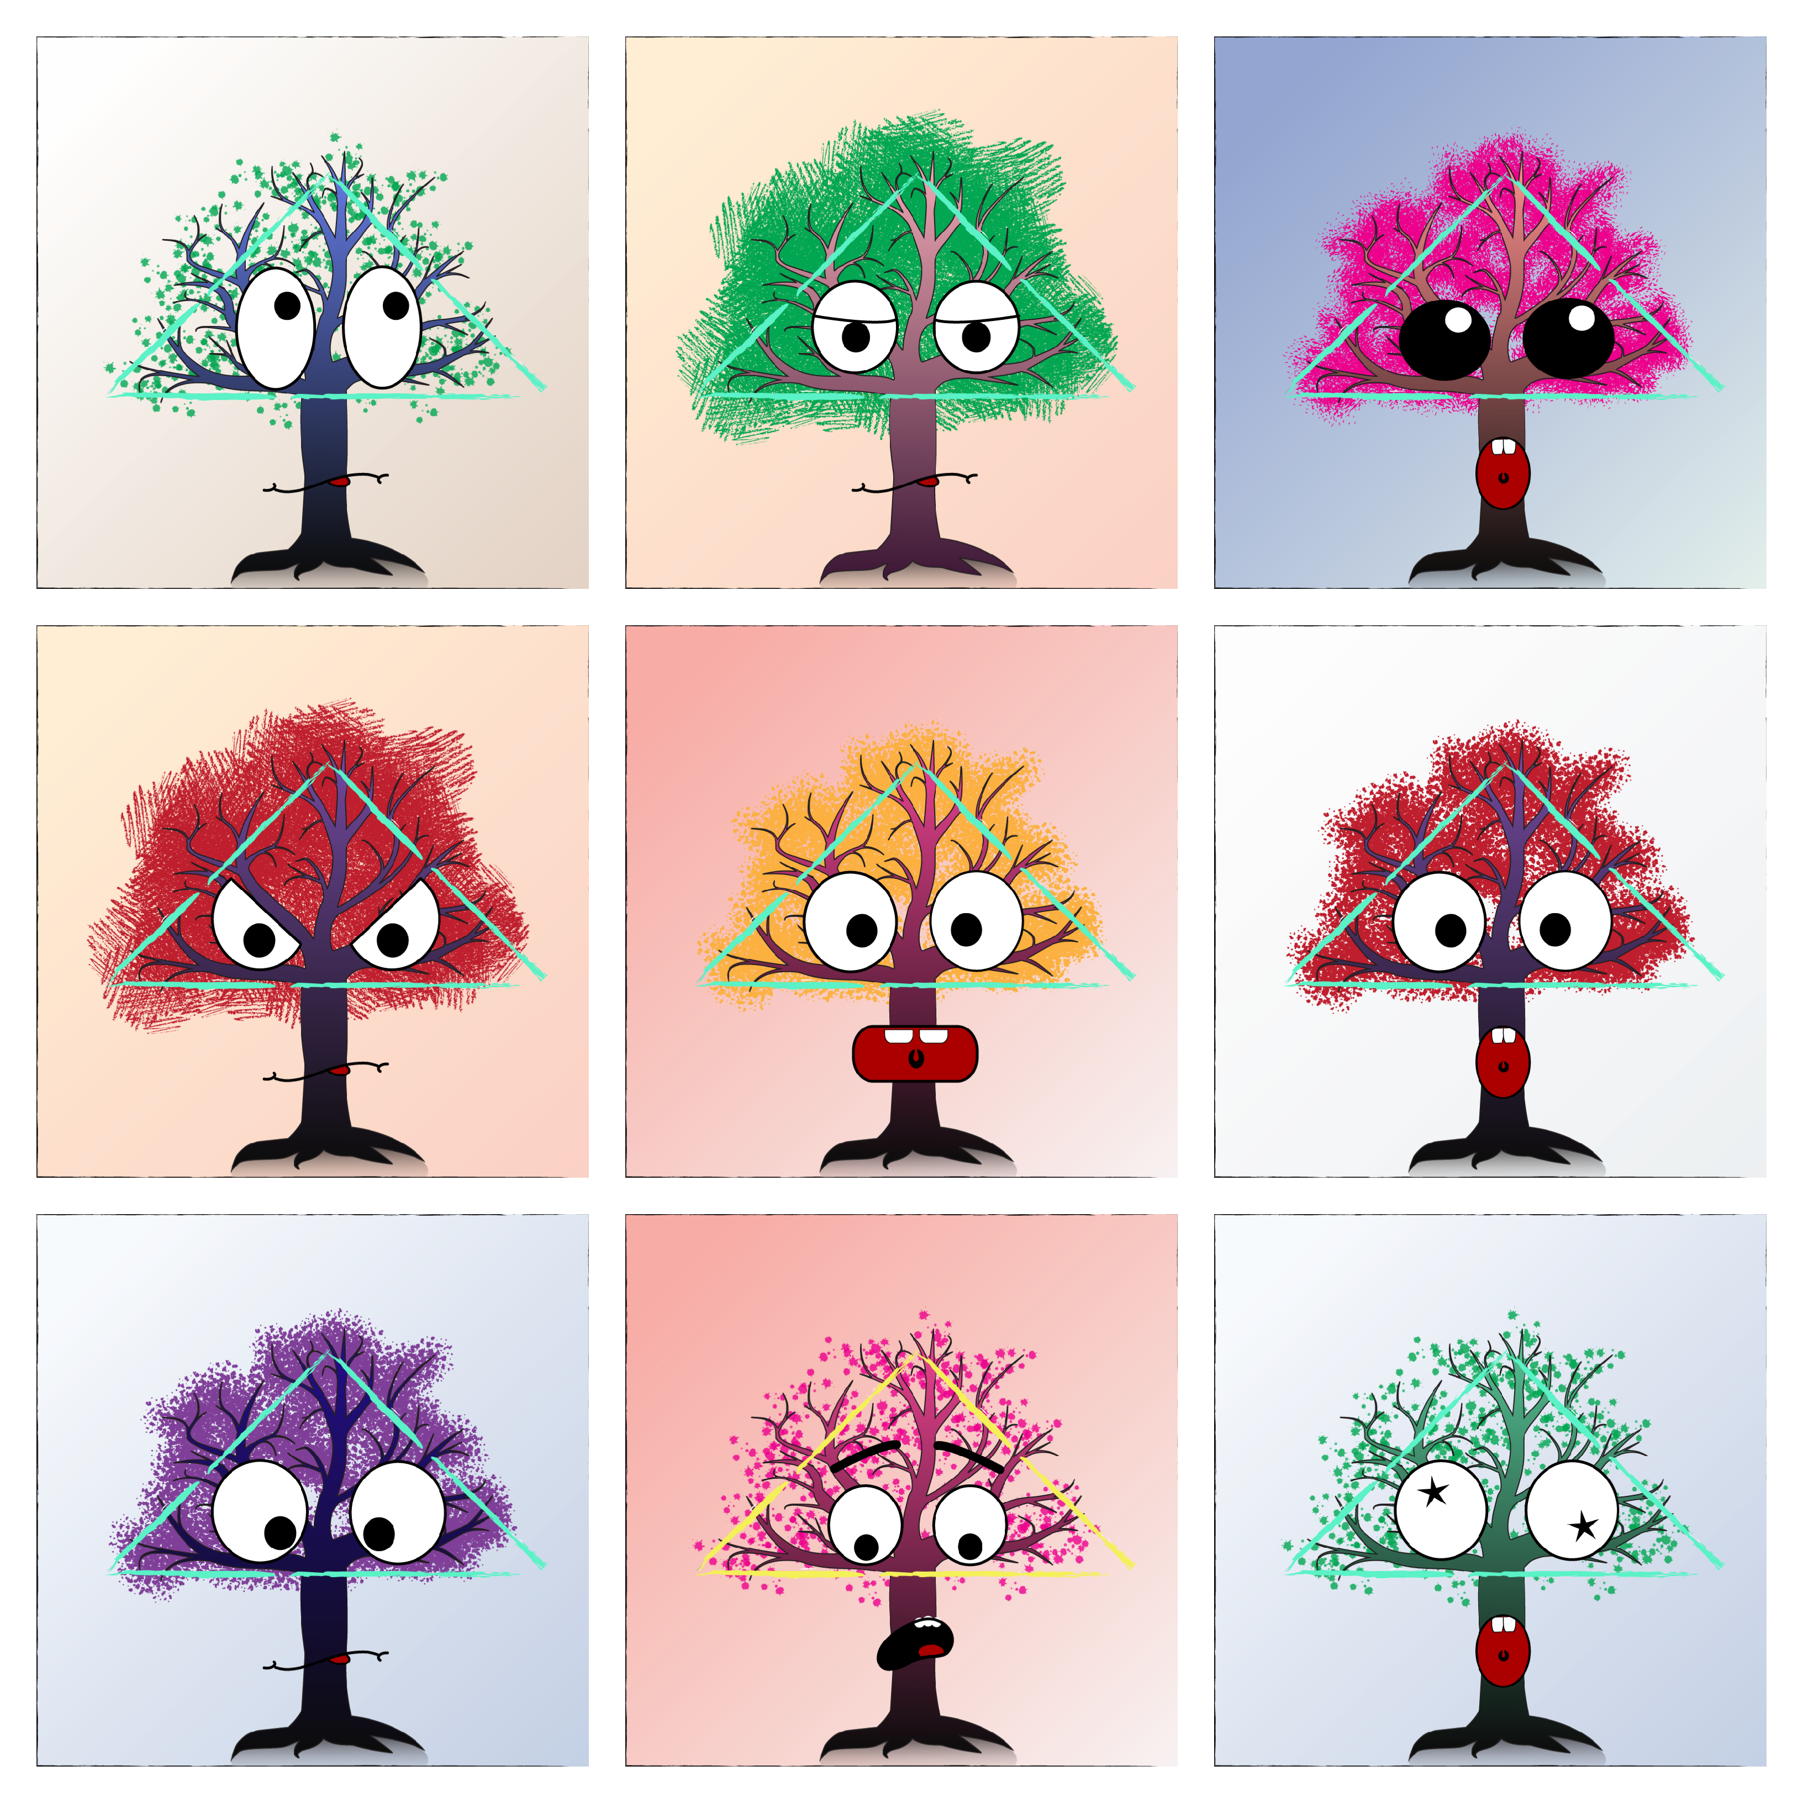
The Lucky Golden Tree NFTs
The Lucky Golden Trees is a unique collection of 11,000 NFTs aiming to create a better and profitable environment for the upcoming generations.
This is an ecological project with goals to provide luxury and benefits to its holders as well as the nature.
We have planned over 30 things for the nature and have 15+ perks for our holders i.e. lots of utility.

Slide 4







The Lucky Golden Tree
Timeline
Stage 1.4
Stage 1.3
The Grand Lucky Golden Planet
03
March 2023
02
Stage 1.2
TLGTVerse & Ecology
September 2022
Marketing & Community Building
01
Stage 1
June 2022
Presale & Whitelisting
March 2022
Level 1
Level 2
Level 3
Level4
2022

Slide 5
Stage 1.1
#1-100
NFT Launch : March 1, 2022
Stage Deadline : May, 2022
Presale & Whitelisting
S. No | Aim | Difficulty
1 | Website Level 1 Launch | Medium
2 | Newsletter | Easy
3 | 5 ETH worth NFTs Public Giveaway* | Easy
4 | Setup of multiple social media profiles | Easy
5 | T-shirt/Merchandise/$500 Giveaway** | Medium
6 | Team Building | Hard
7 | Marketing Level 2 | Medium
8 | Community Airdrop and Awards | Easy
9 | Community conference and Parties | Lovely
* 50 NFTs with a total price of 5 ETH (S-1.4).
** One of the 3 to be elected by the community.

Slide 6
Stage 1.2
Marketing & Community Building
#101-1000
NFT Launch : May, 2022
Stage Deadline : August, 2022
S. No | Aim | Difficulty
1 | Official Merchandise Store | Hard
2 | Digital Bi-Weekly Magazine Launch | Medium
3 | Influencer Partnerships Level 1 | Easy
4 | Social Works | Medium
5 | TLGT DAO | Medium
6 | Building Development and Management Team | Hard
7 | Marketing Level 3 | Medium
8 | Community and Public Airdrop and Awards | Easy
9 | Community conference and Party | Lovely
10 | LGT Verse Concept Launch | Medium

Slide 7
Stage 1.3
#1001-5000
NFT Launch : July, 2022
Stage Deadline : Feb, 2023
TLGT Verse, Ecology
Difficulty of this level is rated Hard on average
This stage road map is available for NFT holders Only.
Public version will be released upon completion of Stage 1.2 work
The Grand Lucky Golden Planet
#5001-11000
NFT Launch : September, 2022
Stage Deadline : October, 2023
Stage 1.4
Difficulty of this level is rated Very Hard on average.
This stage road map is available for NFT holders Only.
Public version will be released after the release of roadmap of Stage 1.3.

Slide 8



The Lucky Golden Tree
Public Roadmap V1
Thank You
For partnership and queries mail to: theluckygoldentree@gmail.com
discord.gg/TR2b7cCKuX
@TLGTree
@TheLuckyGoldenTree
@TLGTree

